Slide 1
It’s TIME for a HERO
By House of Frazer

Slide 2
Team Members
Michael – Factory Level Designer, AI Programmer
Rhys – Ice Level Designer, Graphics Programming
Frazer – Village Level Designer, Story and Lore
Joshua – Hub Designer, UI Programmer, Sound Engineer
Faiz – Rigging, Modelling and Animation, NPC Programmer
Umayr – Player Programming

Slide 3
Game Overview

Slide 4
Genres
Action - Combat mechanics using various ranged spells and melee attack
Fantasy – Designed to look fantasy like trying to keep with the theme as much as possible
Puzzle – levels are designed using puzzles making the player complete them using the time travel mechanic to access new areas

Slide 5
Core Mechanics
Time Travel
Basic Melee and Ranged Attack
Shop System (Health, Mana, Spells, Damage)
Pickups (Money, HP potions, Mana potions)
Enemy/Friendly AI (Time Wizard, Shop Keeper)

Slide 6
What was achieved

Slide 7
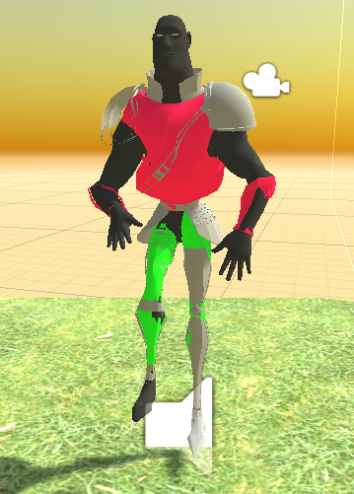
Player
Player has movement for PC and Console builds
Basic and ranged attack
Fully Animated with Walk Cycle

Slide 8

Health System
Gives Player a Set amount of hearts on start
Updates Hearts based on gained health and damage
Updates UI Based On Health (Never exceeding ten hearts)

Slide 9
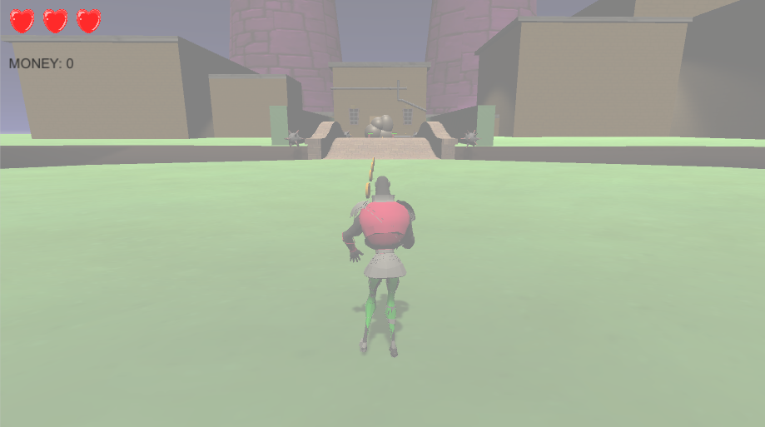
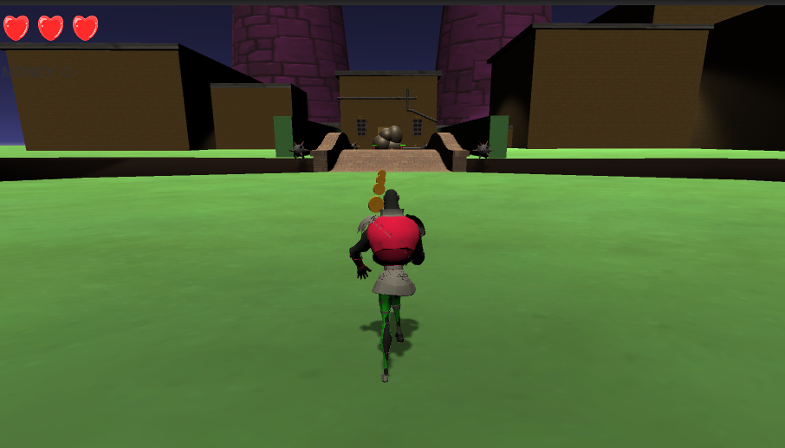

Time Travel
Player can travel back in time between a past and future version of levels
Opens up areas, complete puzzles, collect items
Fades to white and backout as levels are switched

Slide 10
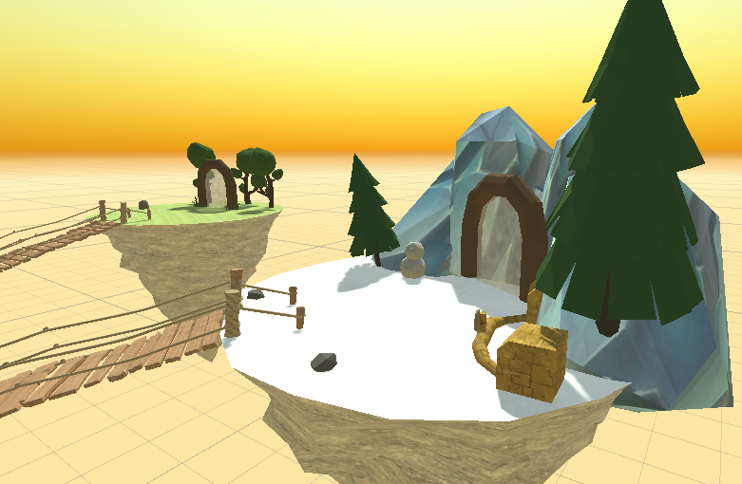
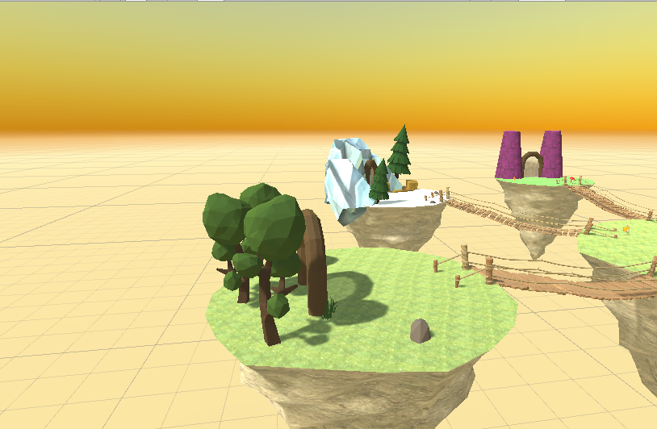
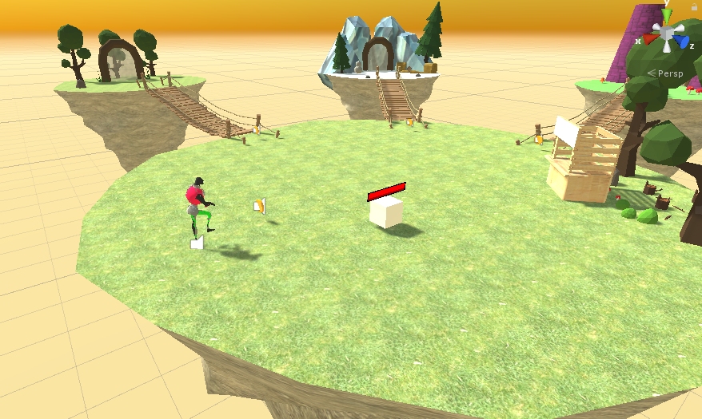
Hub
Split into four different sky islands
Three smaller islands have a portal to each level
Each island is designed after the level it leads to

Slide 11
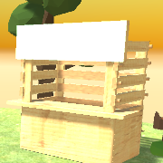

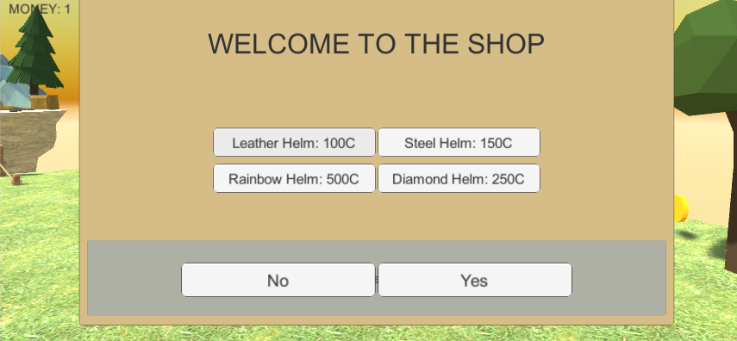
Shop System
Player can access shop to buy cosmetic items
Uses a Coin system which allows player to collect and use coins
Shop is accessed in the hub

Slide 12
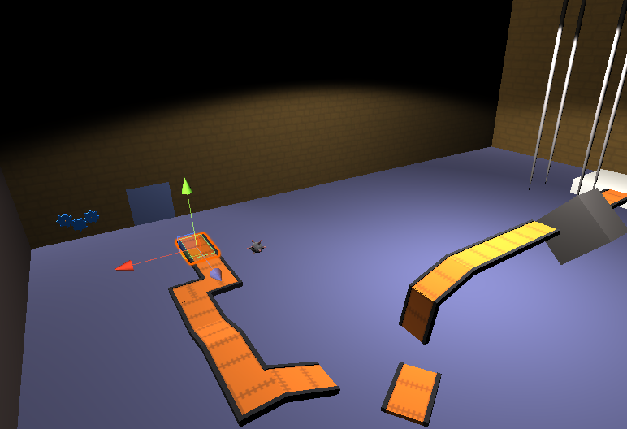
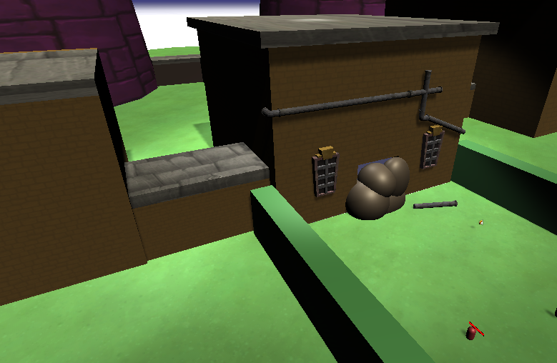
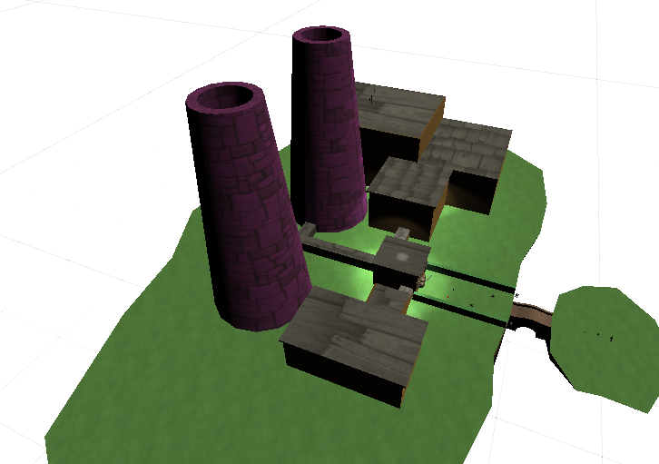
Haunted Factory
Machines work in past, but do not in present.
Ghosts have problems to solves
Time travel to retrieve key cards and help to open doors in past to advance.

Slide 13
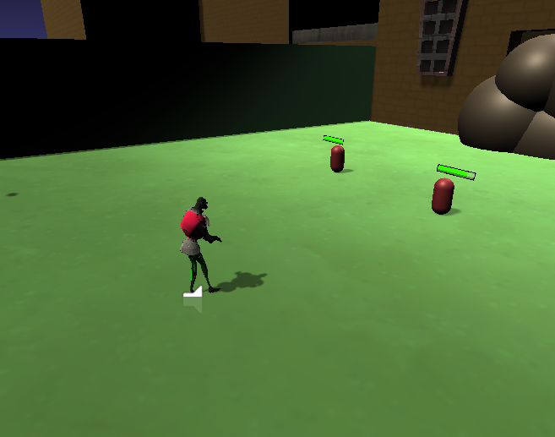
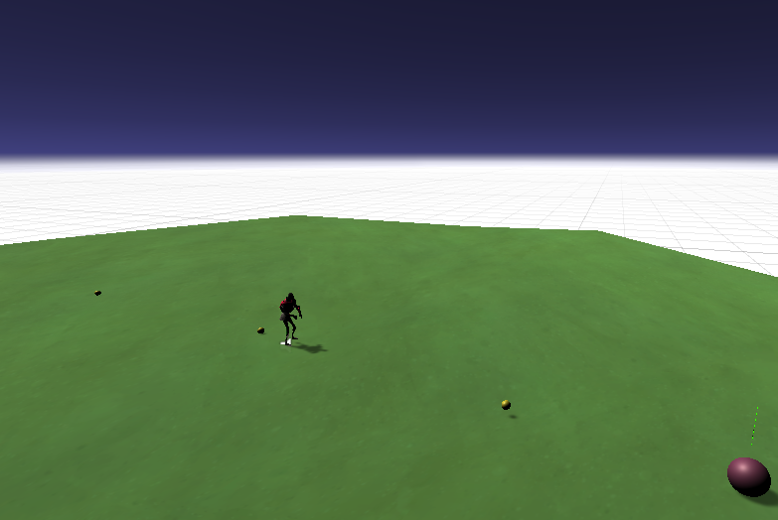
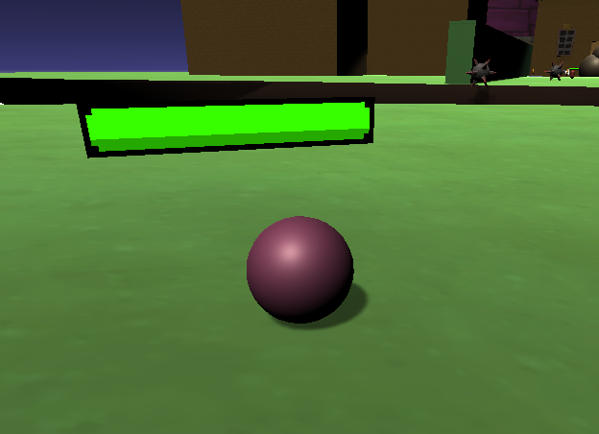
Enemies and AI
State Machine that controls two separate AI
Swarm AI that idles until player is within range and then charges at player.
Ranged AI that idles until player is within range and then enters attack stage.
In it’s attack stage the ranged Ai will keep at a distance from the player and shoot. If the player moves away, the Ai will chase until at firing range. If the player gets closer it move away to keep it’s distance.

Slide 14
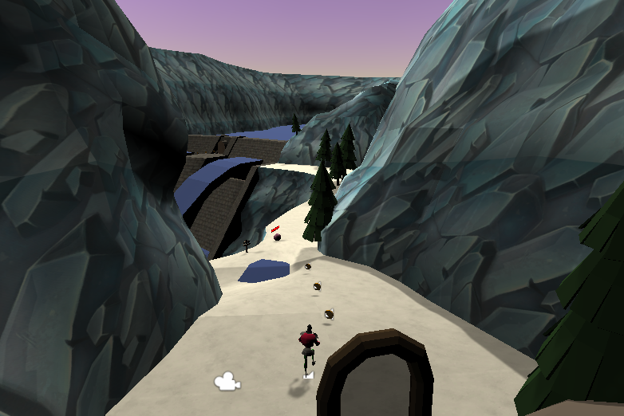
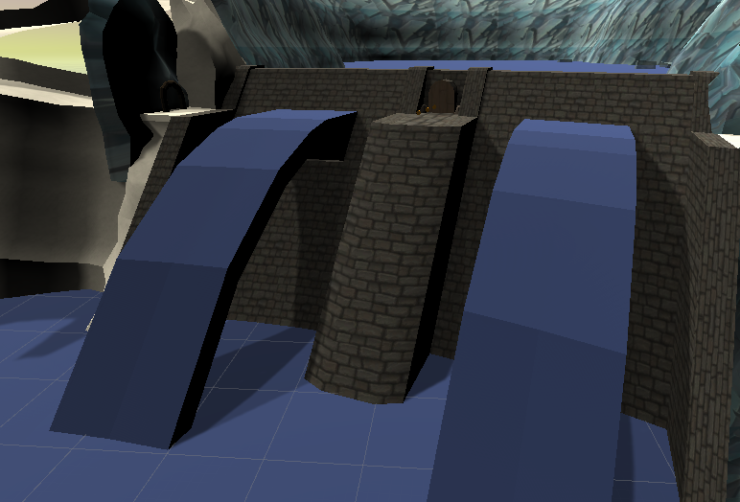
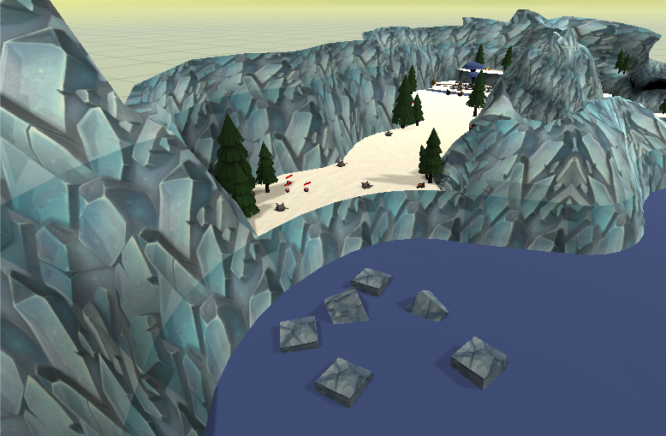
Ice World
Open water valves to change the flow of water
Travel in time to when the water wasn’t frozen
Changing water flow creates new platforms in the future
Impassable ice walls in the future

Slide 15
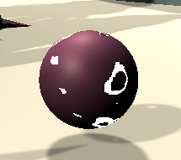

Shaders
Dissolve Shader for Enemies
When enemies die, they dissolve instead of disappearing
Water Shader for water related objects

Slide 16
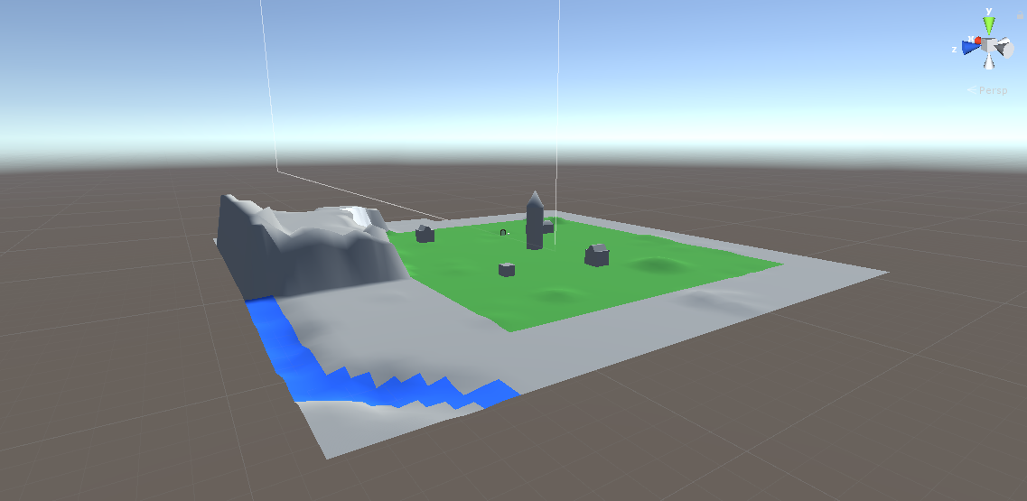
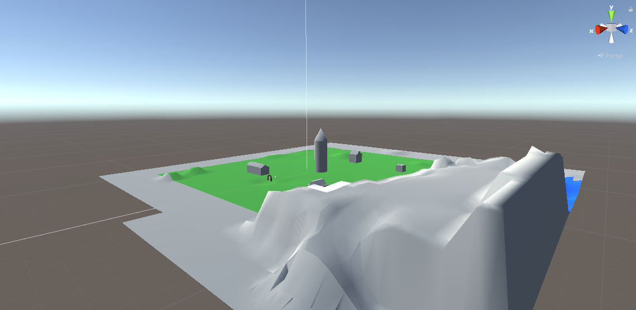
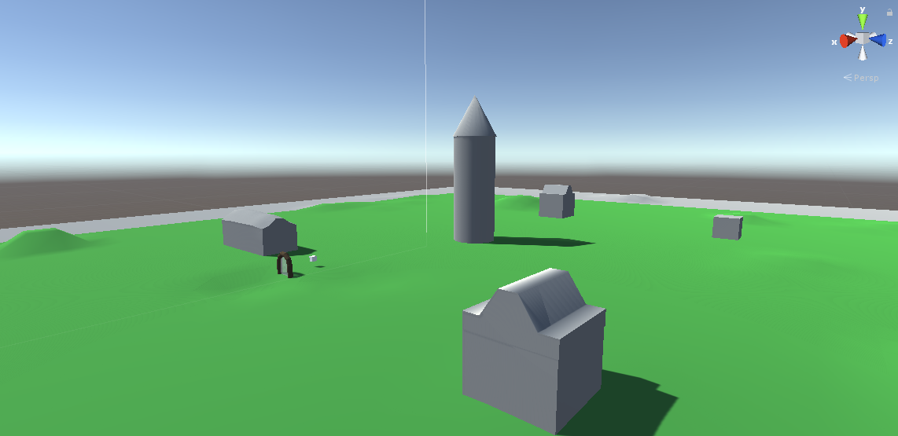
Wooded Village
Travel back in time to where the village is still in construction
Use a blueprint to change the locations of buildings
Plants are overgrown limiting movability in the future

Slide 17
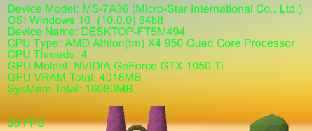
Testing and Performance
Use of button to show debug menu
Shows basic system information and framerate
Comparison of PC builds and Console builds

Slide 18
extenuating circumstances

Slide 19
Shortcomings
Change to online engagement effected the project
Time Constraints meant cutting parts of the project (UI, Water Shader, Friendly AI)
Didn't setup data persistence

Slide 20
Future Development
Fix small bugs and errors
Setup data persistence to all the levels
Incorporate user options such as save/loading, volume setting, resolution
Extend size and content of all the levels
Add more AI/Enemies to the game

Slide 21
Thanks for Listening

